Slide 1
School Vision
Finally, brothers and sisters, whatever is true, whatever is noble, whatever is right, whatever is pure, whatever is lovely, whatever is admirable—if anything is excellent or praiseworthy—think about such things. Whatever you have learned or received or heard from me, or seen in me—put it into practice. And the God of peace will be with you.

Slide 2
School Vision
Finally, brothers and sisters, whatever is true, whatever is noble, whatever is right, whatever is pure, whatever is lovely, whatever is admirable—if anything is excellent or praiseworthy—think about such things. Whatever you have learned or received or heard from me, or seen in me—put it into practice. And the God of peace will be with you.

Slide 3
God of Peace

Slide 4
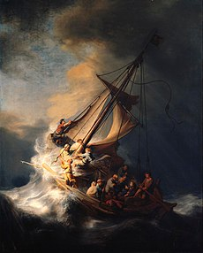
Jesus brings Peace

Slide 7
Further thinking
Where do you find peace?
How can you bring peace?

Slide 8
Our Father in heaven, hallowed be your name, your kingdom come, your will be done, on earth as in heaven. Give us today our daily bread. Forgive us our sins as we forgive those who sin against us. Lead us not into temptation but deliver us from evil. For the kingdom, the power, and the glory are yours now and for ever. Amen.

Slide 9
.

