Slide 1
School Vision
Finally, brothers and sisters, whatever is true, whatever is noble, whatever is right, whatever is pure, whatever is lovely, whatever is admirable—if anything is excellent or praiseworthy—think about such things. Whatever you have learned or received or heard from me, or seen in me—put it into practice. And the God of peace will be with you.

Slide 2
School Vision
Finally, brothers and sisters, whatever is true, whatever is noble, whatever is right, whatever is pure, whatever is lovely, whatever is admirable—if anything is excellent or praiseworthy—think about such things. Whatever you have learned or received or heard from me, or seen in me—put it into practice. And the God of peace will be with you.

Slide 3
School Vision
When Paul is writing to the Philippians, he calls them his ‘brothers and sisters’…..
But they are not related to him
So why?

Slide 4
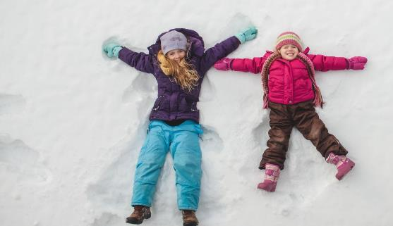
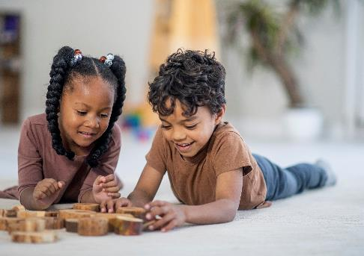
Brothers and Sisters

Slide 5
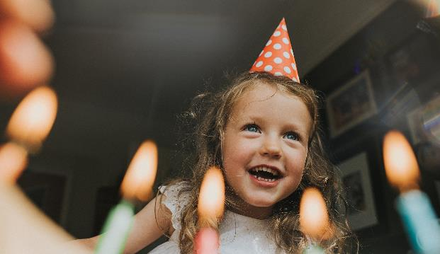
Brothers and Sisters: Question 1
When is brother / sister’s birthday?

Slide 6
Brother and Sisters: Question 2
What is your brother/ sister’s favourite colour?

Slide 7
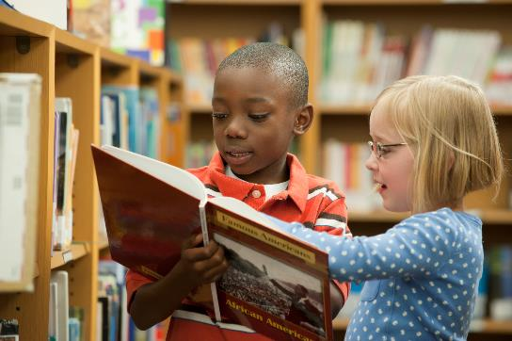
Brother and Sisters: Question 3
Who is your brother / sister’s best friend?

Slide 8
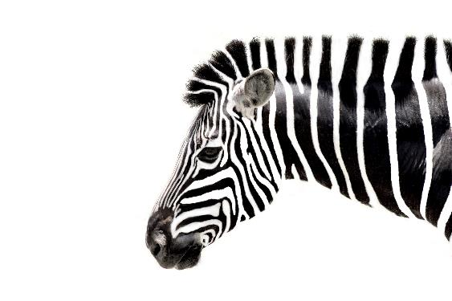
Brother and sister: Question 4
If your brother / sister could be an animal for a day, which animal would they be?

Slide 9
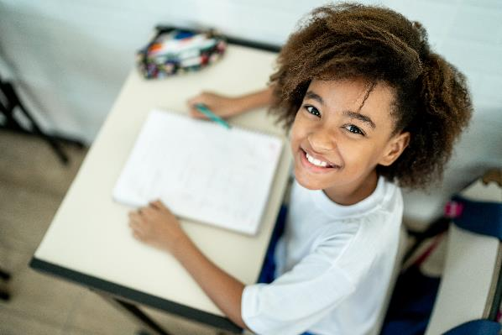
Brothers and sisters: Question 5
What is your brother / sister’s favourite subject?

Slide 10
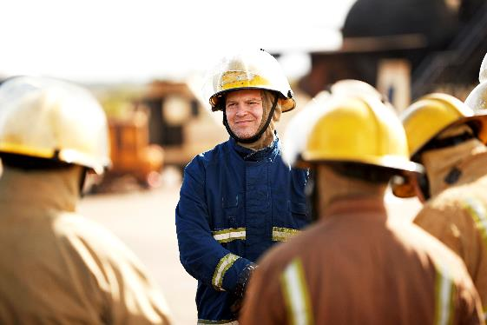
Brother and sisters: Question 6
What is your brother /sister’s dream job?

Slide 11
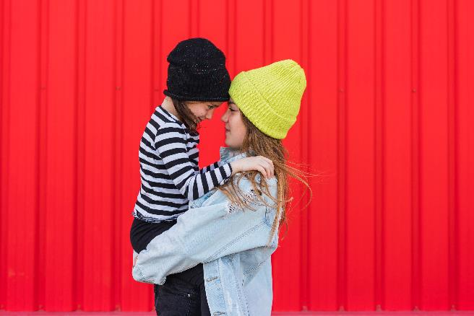
Brother and sisters: Question 7
Does your brother / sister care for you?

Slide 12
Brother and sisters: Question 8
Does your brother / sister teacher you new things?

Slide 13
Brother and sisters are people who
know each other well
should care for each other
who learn together

Slide 14
Paul is saying that Christians are people who should:
know each other well
should care for each other
who learn together

Slide 15
At St Mary’s School we are inspired by this vision. We want our children and adults to be like ‘brothers and sisters’ who
know each other well
care for each other
who learn together

Slide 16
At St Mary’s School we are inspired by this vision. We want our children and adults to be like ‘brothers and sisters’ who
know each other well so no one is left out
care for each other because all are valued
who learn together from the example of Jesus and one another

Slide 17
How can you make sure that at our school we
know each other well so no one is left out
care for each other because all are valued
who learn together from the example of Jesus and one another

Slide 18
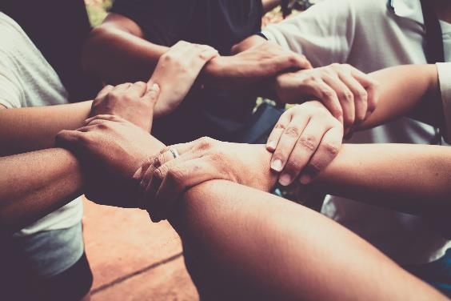
Further thinking
What would it mean if we thought of all people as brothers and sisters?

Slide 19
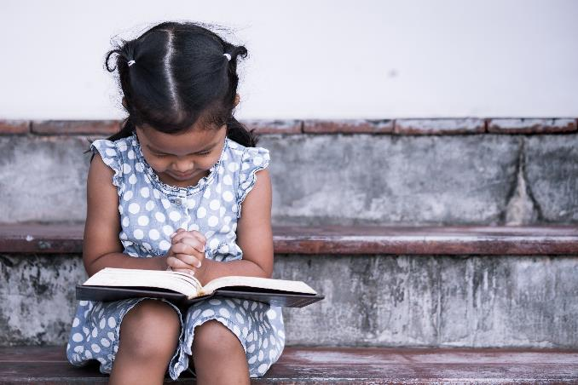
Our Father in heaven, hallowed be your name, your kingdom come, your will be done, on earth as in heaven. Give us today our daily bread. Forgive us our sins as we forgive those who sin against us. Lead us not into temptation but deliver us from evil. For the kingdom, the power, and the glory are yours now and for ever. Amen.

Slide 20
.

