Slide 1
School Vision
Finally, brothers and sisters, whatever is true, whatever is noble, whatever is right, whatever is pure, whatever is lovely, whatever is admirable—if anything is excellent or praiseworthy—think about such things. Whatever you have learned or received or heard from me, or seen in me—put it into practice. And the God of peace will be with you.

Slide 2
Our Vision
whatever is true, whatever is noble, whatever is right, whatever is pure, whatever is lovely, whatever is admirable—if anything is excellent or praiseworthy—think about such things.

Slide 3
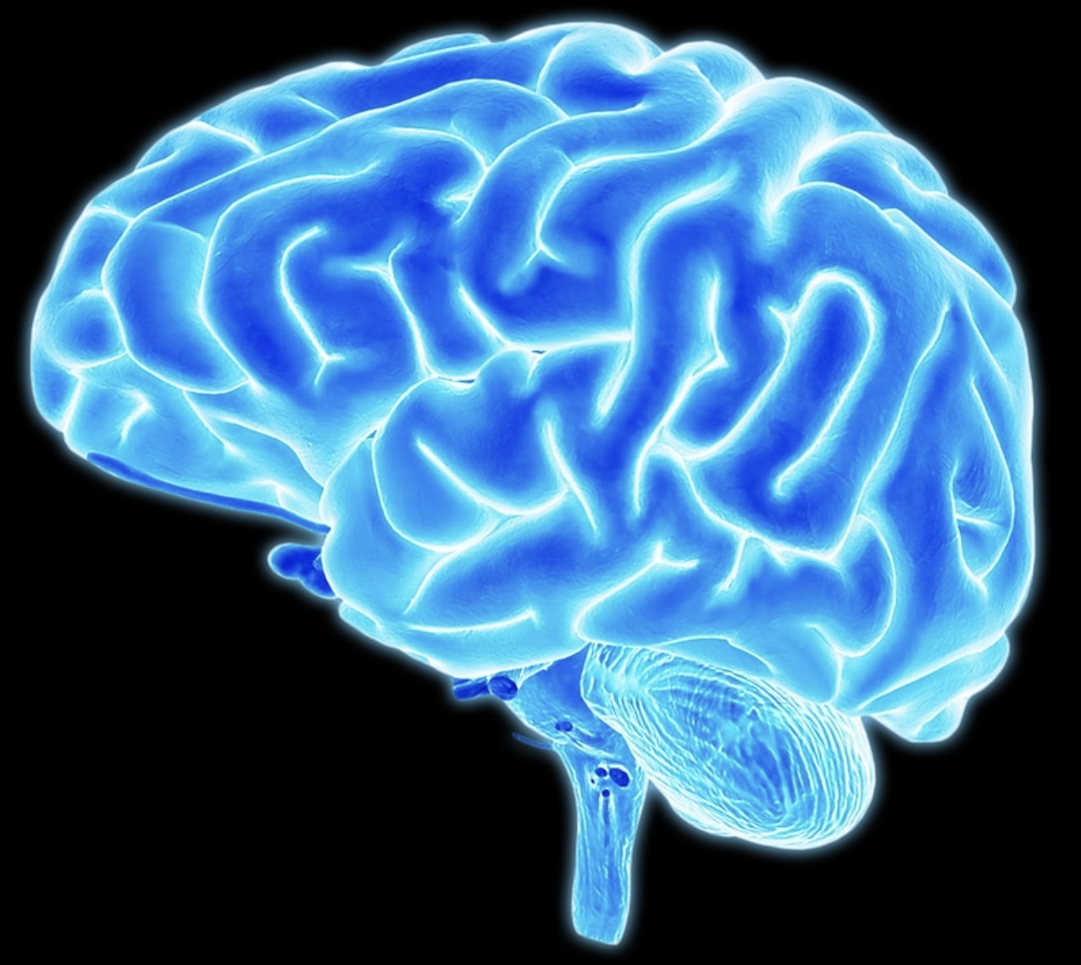
Think on such things: Your Amazing Brian

Slide 4
You carry around a three-pound mass of wrinkly material in your head that controls every single thing you will ever do. From enabling you to think, learn, create, and feel emotions to controlling every blink, breath, and heartbeat—this fantastic control center is your brain. It is a structure so amazing that a famous scientist once called it "the most complex thing we have yet discovered in our universe."

Slide 6
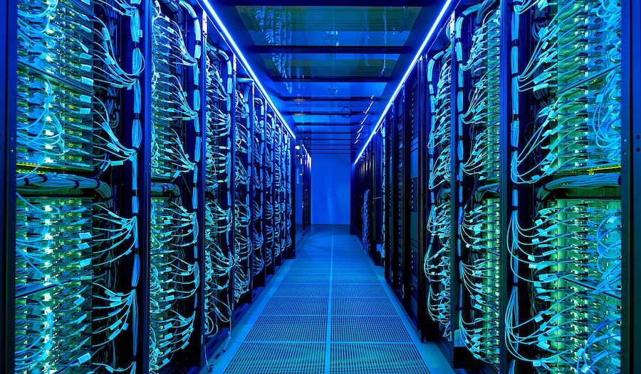

Slide 7
Your brain contains about 100 billion microscopic cells called neurons—so many it would take you over 3,000 years to count them all. Whenever you dream, laugh, think, see, or move, it’s because tiny chemical and electrical signals are racing between these neurons along billions of tiny neuron highways. Believe it or not, the activity in your brain never stops.

Slide 8
messages zip around like a supercharged pinball machine

Slide 9
Your neurons create and send more messages than all the phones in the entire world.

Slide 10
Your brain generates enough electricity to power a lightbulb.

Slide 11
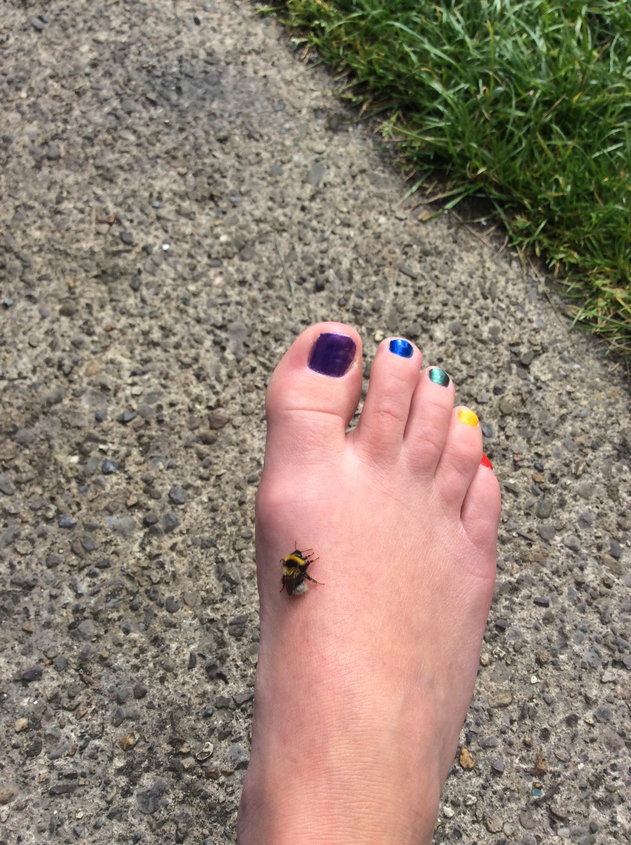

Slide 12
Sensory neurons in your skin relay this information to your spinal cord and brain at a speed of more than 150 miles (241 kilometers) per hour. Your brain then uses motor neurons to transmit the message back through your spinal cord to your foot to shake the bee off quickly. Motor neurons can relay this information at more than 200 miles (322 kilometers) per hour.

Slide 13
When you learn, you change the structure of your brain.

Slide 14
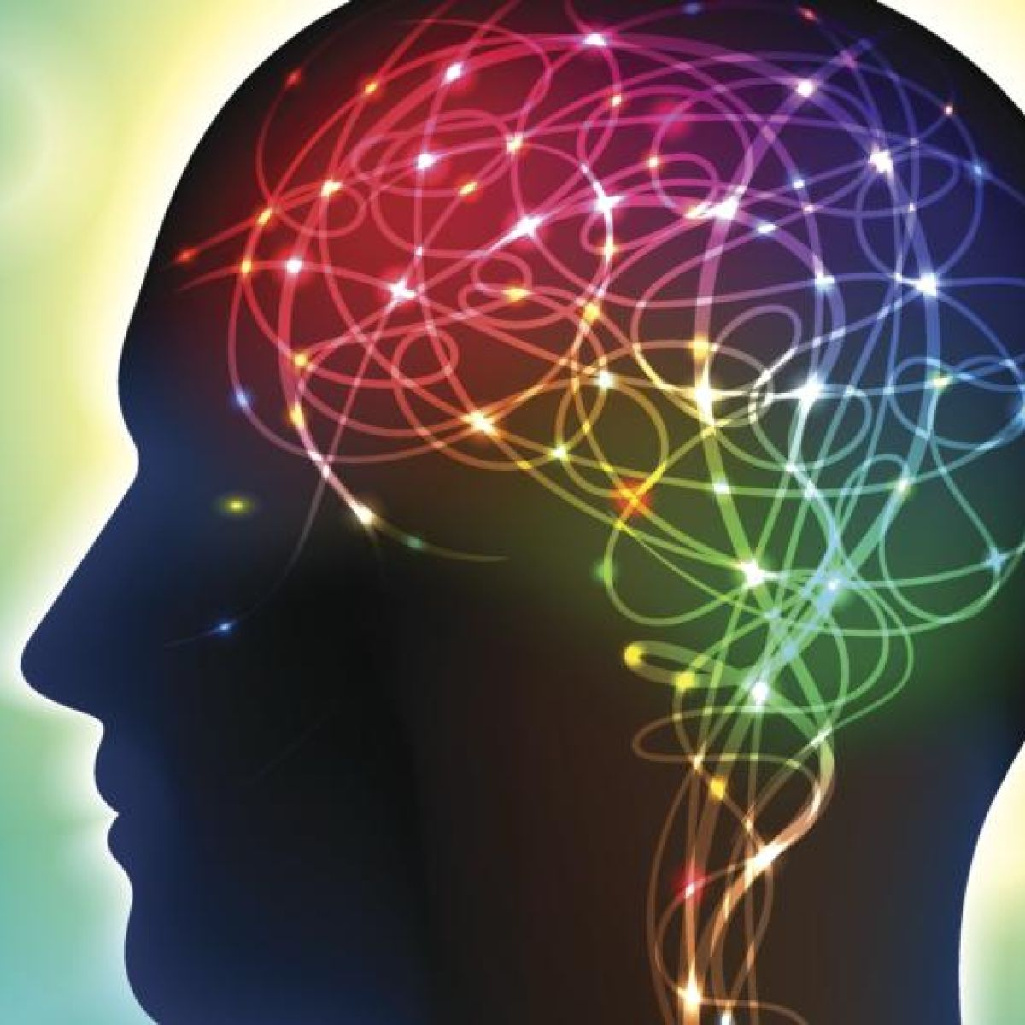
What we think about matters…

Slide 15
How we use our brains matters
whatever is true, whatever is noble, whatever is right, whatever is pure, whatever is lovely, whatever is admirable—if anything is excellent or praiseworthy—think about such things.

Slide 16
Further thinking
What things can help us fill our minds with noble and right thoughts?
What kind of things should we avoid?

Slide 17
Our Father in heaven, hallowed be your name, your kingdom come, your will be done, on earth as in heaven. Give us today our daily bread. Forgive us our sins as we forgive those who sin against us. Lead us not into temptation but deliver us from evil. For the kingdom, the power, and the glory are yours now and for ever. Amen.

